Slide 1
Bolton Academy Budget Feedback Meeting
GO Team
February 26, 2024

Slide 2
Norms
This is a meeting of the GO Team. Only members of the team may participate in the discussion. Any members of the public present are here to quietly observe.
We will follow the agenda as noticed to the public and stay on task.
We invite and welcome contributions of every member and listen to each other.
We will respect all ideas and assume good intentions.

Slide 3
GO Team Budget Development Process
YOUR SCHOOL STRATEGIC PLAN…
is your roadmap and your role.
It is your direction, your priorities, your vision, your present, your future.
Step 1: Data Review
Step 2: Strategic Plan Review
Step 3: Budget Parameters
(Strategic Priorities)
Step 4: Budget Choices
Notes:
Today I will provide an overview of the budget allocations for FY23. We will begin the work of funding the strategic priorities we agreed upon during our strategic review meeting.

Slide 4
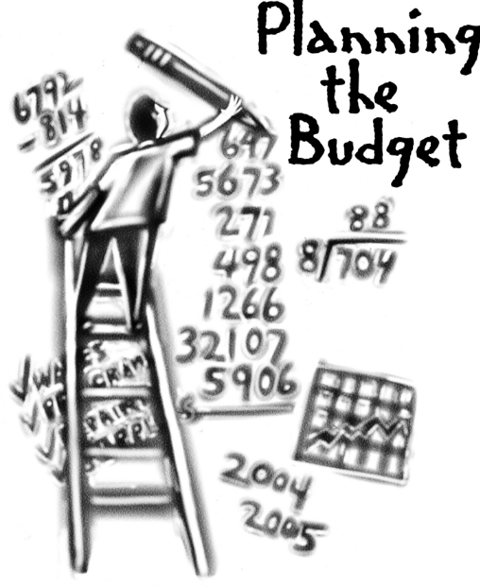
Overview of FY ‘25 GO Team Budget Process
Step 2 Principals: Workshop FY 25 Budget
January 17
Step 4 Principals: Associate Supt. Discussions and Review
February (supports needed, specific challenges, coaching)
Step 1 Review and Update Strategic Plan
Step 6 Principals: HR Staffing Conferences Begin
Late February – Early March
Step 3 GO Team Initial Budget Session
January 17 – early February
Step 7 GO Team Final Budget Approval Meeting
Budgets Approved by March 15
Step 5 GO Team Feedback Session
February – ongoing if necessary
GO Teams are encouraged to have ongoing conversations

Slide 5
Budget Feedback Meeting
What
The GO Team feedback session(s) should be scheduled for the principal to provide an overview of the school’s draft budget for the GO Team members and the general public.
Why
This meeting provides an opportunity for GO Teams to discuss how the school’s budget has been allocated to support the programmatic needs and key strategic priorities.
When
Meetings must be held in February before staffing conferences. May be combined with the allocation meeting (as needed), if the GO Team has completed strategic plan updates and ranked strategic priorities.
Notes:
Looking for general consensus prior to Staffing Conferences

Slide 6
FY25 Budget Parameters
FY25 School Priorities | Rationale
Increase student performance in Math | About 60% of 3-5 students are not meeting mastery the standards as measured by MATH GMAS (proficient/distinguished)
Increase student performance in ELA | About 45% of 3-5 students are not meeting mastery the standards as measured by ELA GMAS (proficient/distinguished)
Embed a data-driven, multi-tiered system of support to improve our multi-lingual learner performance | We need to decrease the GAP of academic performance in our EL subgroups as measured by GMAS (proficient/distinguished)
Notes:
Review the priorities that the GO Team has developed and the rationale for these priorities. Feel free to copy this slide if you have more than 3 priorities to account for.

Slide 7
Descriptions of Strategic Plan
Breakout Categories
Priorities: FY25 funding priorities from the school’s strategic plan, ranked by the order of importance.
APS Five Focus Area: What part of the APS Five is the priority aligned to?
Strategies: Lays out specific objectives for school’s improvement.
Request: “The Ask” What needs to be funded in order to support the strategy?
Amount: What is the cost associated with the Request?

Slide 8
FY25 Strategic Plan Break-out
Priorities | APS FIVE Focus Area | Strategies | Requests | Amount
Increase level of rigor and relevance (example- please remove) | Fostering Academic Excellence for All (example- please remove) | Implementation of guided reading training for all staff (example- please remove) | Purchase an additional Teacher (example- please remove) | $84, 134 (example- please remove)
Increase performance in ELA and Math | Curriculum & Instruction Whole Chile | Decreasing Class Sizes | Add a 5th Grade Teacher | 106,000
Increase performance in Math | Curriculum & Instruction Data | Implementing Content specific instructional coaches | Change Master Teacher to Math Coach | Change of about 16,000
EXAMPLE
Notes:
For the next few slides, I will show you how I have allocated the budget to support our strategic priorities.
Based on our strategic priorities and funds we received, here is a break-out of the priorities, which focus area it addresses, the strategies that will be implemented, the purchase request, which funding source was used and the amount.

Slide 9
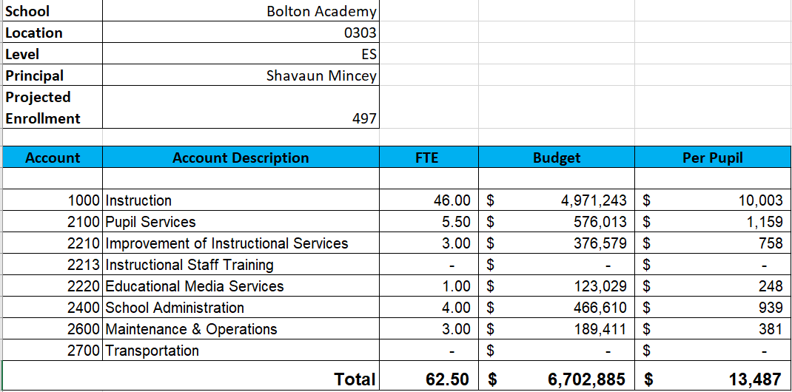
FY25 Budget by Function (Required)
*Based on Current Allocation of School Budget
Notes:
Look at the table to see what makes up each category. Although the school’s total budget amount will not change, allocation per function may change depending on our conversations and school needs.

Slide 10
FY25 Budget by Function (Required)
*Based on Current Allocation of School Budget
Notes:
Explain the pie chart and allocations

Slide 11
Discussion of reserve and Holdback funds

Slide 12
Plan for FY25 Leveling Reserve
$__(83,451)___
Priorities | APS FIVE Focus Area | Strategies | Requests | Amount
Increase student performance in Math | Curriculum & Instruction Personalized learning | Continue to use curriculum resources online for teachers and students | School Supplies, Incentives, Instructional Materials | $40,000
Increase student performance in ELA | Curriculum & Instruction | Training, Material, and Subs | Training and Subs | 33,451
Increase Attendance, Decrease Incidents | Whole Child | Bike Raffles Attendance Parties MAP Growth Celebrations Dojo Store | Student Incentives | 10,000
Notes:
For the next few slides, I will show you how I have allocated the budget to support our strategic priorities.
Based on our strategic priorities and funds we received, here is a break-out of the priorities, which focus area it addresses, the strategies that will be implemented, the purchase request, which funding source was used and the amount.

Slide 13
Plan for FY25 Title I Holdback
$___(Insert Amount Here)___
Priorities | APS FIVE Focus Area | Strategies | Requests | Amount
Increase level of rigor and relevance (example- please remove) | Fostering Academic Excellence for All (example- please remove) | Implementation of guided reading training for all staff (example- please remove) | Purchase an additional Teacher (example- please remove) | $84, 134 (example- please remove)
EXAMPLE
Notes:
For the next few slides, I will show you how I have allocated the budget to support our strategic priorities.
Based on our strategic priorities and funds we received, here is a break-out of the priorities, which focus area it addresses, the strategies that will be implemented, the purchase request, which funding source was used and the amount.

Slide 14
Summary of position Changes to Support the Strategic Plan
CREATED | REMOVED
5th Grade Teacher | n/a
Math Instructional Coach | DLI Master Teacher (16,000 difference)
Summary of Changes
Principals: Please provide a summary of the impact of these changes and how they relate to your strategic plan.

Slide 15
Questions for the GO Team to Consider and Discuss
Are our school’s priorities (from your strategic plan) reflected in this budget?
Are new positions and/or resources included in the budget to address our major priorities?
Do we know (as a team) the plan to support implementation of these priorities beyond the budget (ex. What strategies will be implemented)?
What tradeoffs are being made in order to support these priorities?
How are district and cluster priorities reflected in our budget?
Cluster priorities- what staff, materials, etc. are dedicated to supporting our cluster’s priorities?
Signature programs- what staff, materials, etc. are dedicated to supporting our signature program?
Are there positions our school will share with another school, i.e. nurse, counselor?
Notes:
CHAIR - Our final task for today! Here are questions that we need to consider to ensure we have a good working draft budget. Let’s walk through them together.

Slide 16
Where We’re Going?
Our next meeting is the Budget Approval Meeting
What:
During this meeting we will review the budget, which should be updated based on feedback from the staffing conference, Associate Superintendents, and key leaders. After review, GO Teams will need to take action (i.e., vote) on the FY25 Budget.
Why:
Principals will present the final budget recommendations for GO Team approval.
When:
All approval meetings must be held after staffing conferences. Budgets must be approved by March 15th.

Slide 17
What’s Next?
February
HR Staffing Conferences (Late February)
March
Final GO Team Approval Meeting (AFTER your school’s Staffing Conference and BEFORE Friday, March 15th)
Notes:
In February, we will meet again to discuss how the school’s budget has been allocated to support the programmatic needs and FY23 key strategic priorities.
If think we need to continue our budget conversations, we will schedule additional meetings. My goal is to make sure your voices are reflected in our school’s budget.
I will also be meeting with my Associate Superintendent, program managers and other key leaders to go over our budget and to make sure the school is meeting the standards of service and appropriately staffing.
During the week of Feb. 24th -March 2nd , HR Staffing Conferences will be held. At this meeting, I will present my plan for staff utilization, resource distribution and plan for staffing implications.
We will need to approve the budget at the ________ meeting.

Slide 18
Thank you

